Slide 1
Musculoskeletal System
Krishna Bastola
B.Sc. MLT, M.Sc.

Slide 2
Introduction
The skeleton consists of cartilage and bone.
Cartilage has a role in growth and repair of bone, and in the adults forms the articular skeleton responsible for movement of joints.
Bone is a specialised form of connective tissue which performs the function of providing mechanical support and is also a mineral reservoir for calcium homeostasis.
There are 206 bones in the human body, and depending upon their size and shape may be long, flat, tubular, etc.

Slide 3
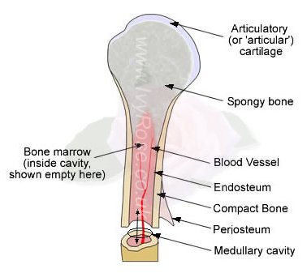
Structure of Bone

Slide 4
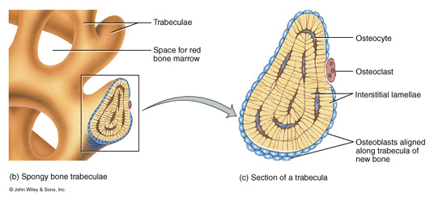
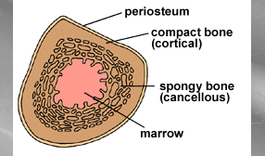
Structure of Bone
All bones consist of a dense, solid outer layer known as compact bone and an inner layer of spongy bone – a honeycomb of flat, needle-like projections called trabeculae.

Slide 5
Structure of Bone
The marrow cavity and the spaces of spongy bone (present at the bone ends) are filled by a highly vascular tissue called bone marrow.
At the both ends the marrow is red in colour. Apart from blood vessels this red marrow contains numerous masses of blood forming cell (haemopoietic tissue).
In the shaft of the bone of an adult, the marrow is yellow. This yellow marrow is made up predominantly of fat cells.
In bones of a fetus, or of a young child the entire bone marrow is red. The marrow in the shaft is gradually replaced by yellow marrow with increasing age.

Slide 6
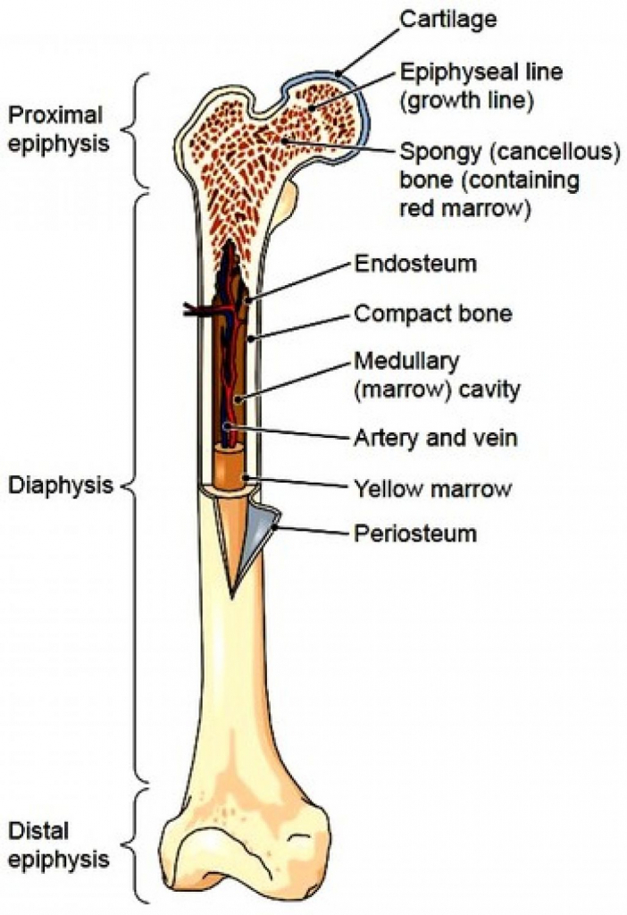
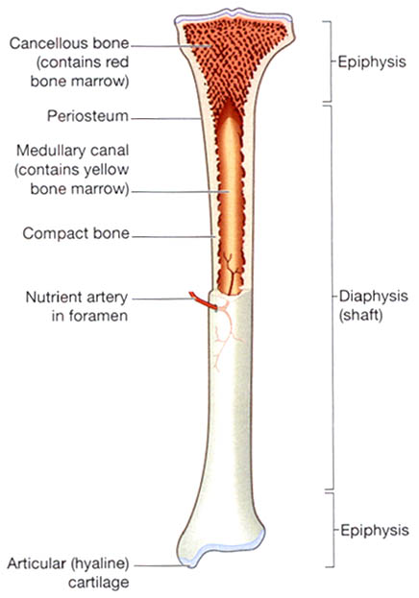
Endosteum
Fig: A mature long bone

Slide 7
Structure of Bone
HISTOLOGY
Bone consists of large quantities of extracellular matrix which is loaded with calcium hydroxyapatite and relatively small number of bone cells which are of 3 main types: osteoblasts, osteocytes and osteoclasts, besides the ground substance, the osteoid matrix.
Osteoblast:
uninucleate cells found abundantly along the new bone forming surfaces.
synthesize bone matrix ( also, bone forming cells)
serum levels of bone-related alkaline phosphatase is a marker for osteoblastic activity
its levels are raised in puberty during period of active bone growth and in pathologic conditions associated with high osteoblastic activity such as in fracture repair and Paget’s disease of the bone.

Slide 8
Structure of Bone
HISTOLOGY
Osteocytes:
Osteocytes are those osteoblasts which get incorporated into the bone matrix during its synthesis.
found within small spaces called lacunae lying in the bone matrix.
Osteoclasts:
large multinucleate cells of mononuclear-macrophage origin and are responsible for bone resorption (absorption and removal of bone).
The osteoclastic activity is determined by bone-related serum acid phosphatase levels.
found along the endosteal surface of the cortical (compact) bone and the trabeculae of trabecular (cancellous) bone.
Osteoid matrix
The osteoid matrix of bone consists of 90-95% of collagen type I and comprises nearly half of total body’s collagen.

Slide 9
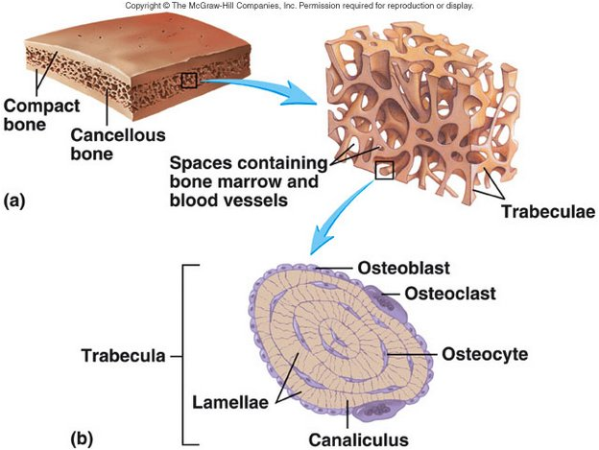
Structure of Spongy Bone

Slide 10
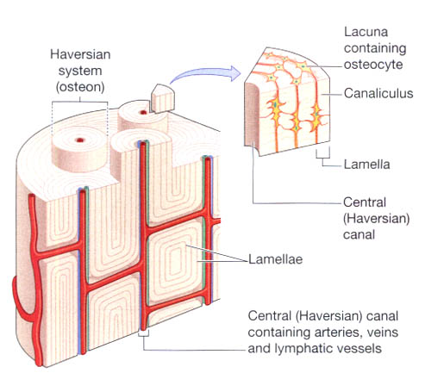
Structure of Compact Bone

Slide 11
Metabolic Disorders

Slide 12
Metabolic Disorders
Rickets/Osteomalacia

Slide 13
Metabolic Disorders
Rickets/Osteomalacia:
A deficiency disease resulting from a lack of vitamin D or calcium and from insufficient exposure to sunlight, characterised by defective bone growth and occurring chiefly in children.
The failure of bone osteoid to mineralise is called osteomalacia. In children, the disease is called rickets.
Rickets occurs in children and osteomalacia in adults after ossification is complete.
They are caused by deficiency of vitamin D which promotes calcification of bone and absorption of calcium in the small intestine.
The bones remain soft and those of the lower limbs become bowed by the weight of the body.

Slide 14
Metabolic Disorders
7-dehydrocholesterol
Sunlight
Skin
Cholecalciferol ; D3
25-hydroxylase (liver)
25-hydroxycholecalciferol
1α-hydroxylase (kidney)
1,25-dihydroxycholecalciferol (calcitriol)
Fig: Biosynthesis of active form of vitamin D; calcitriol.

Slide 15
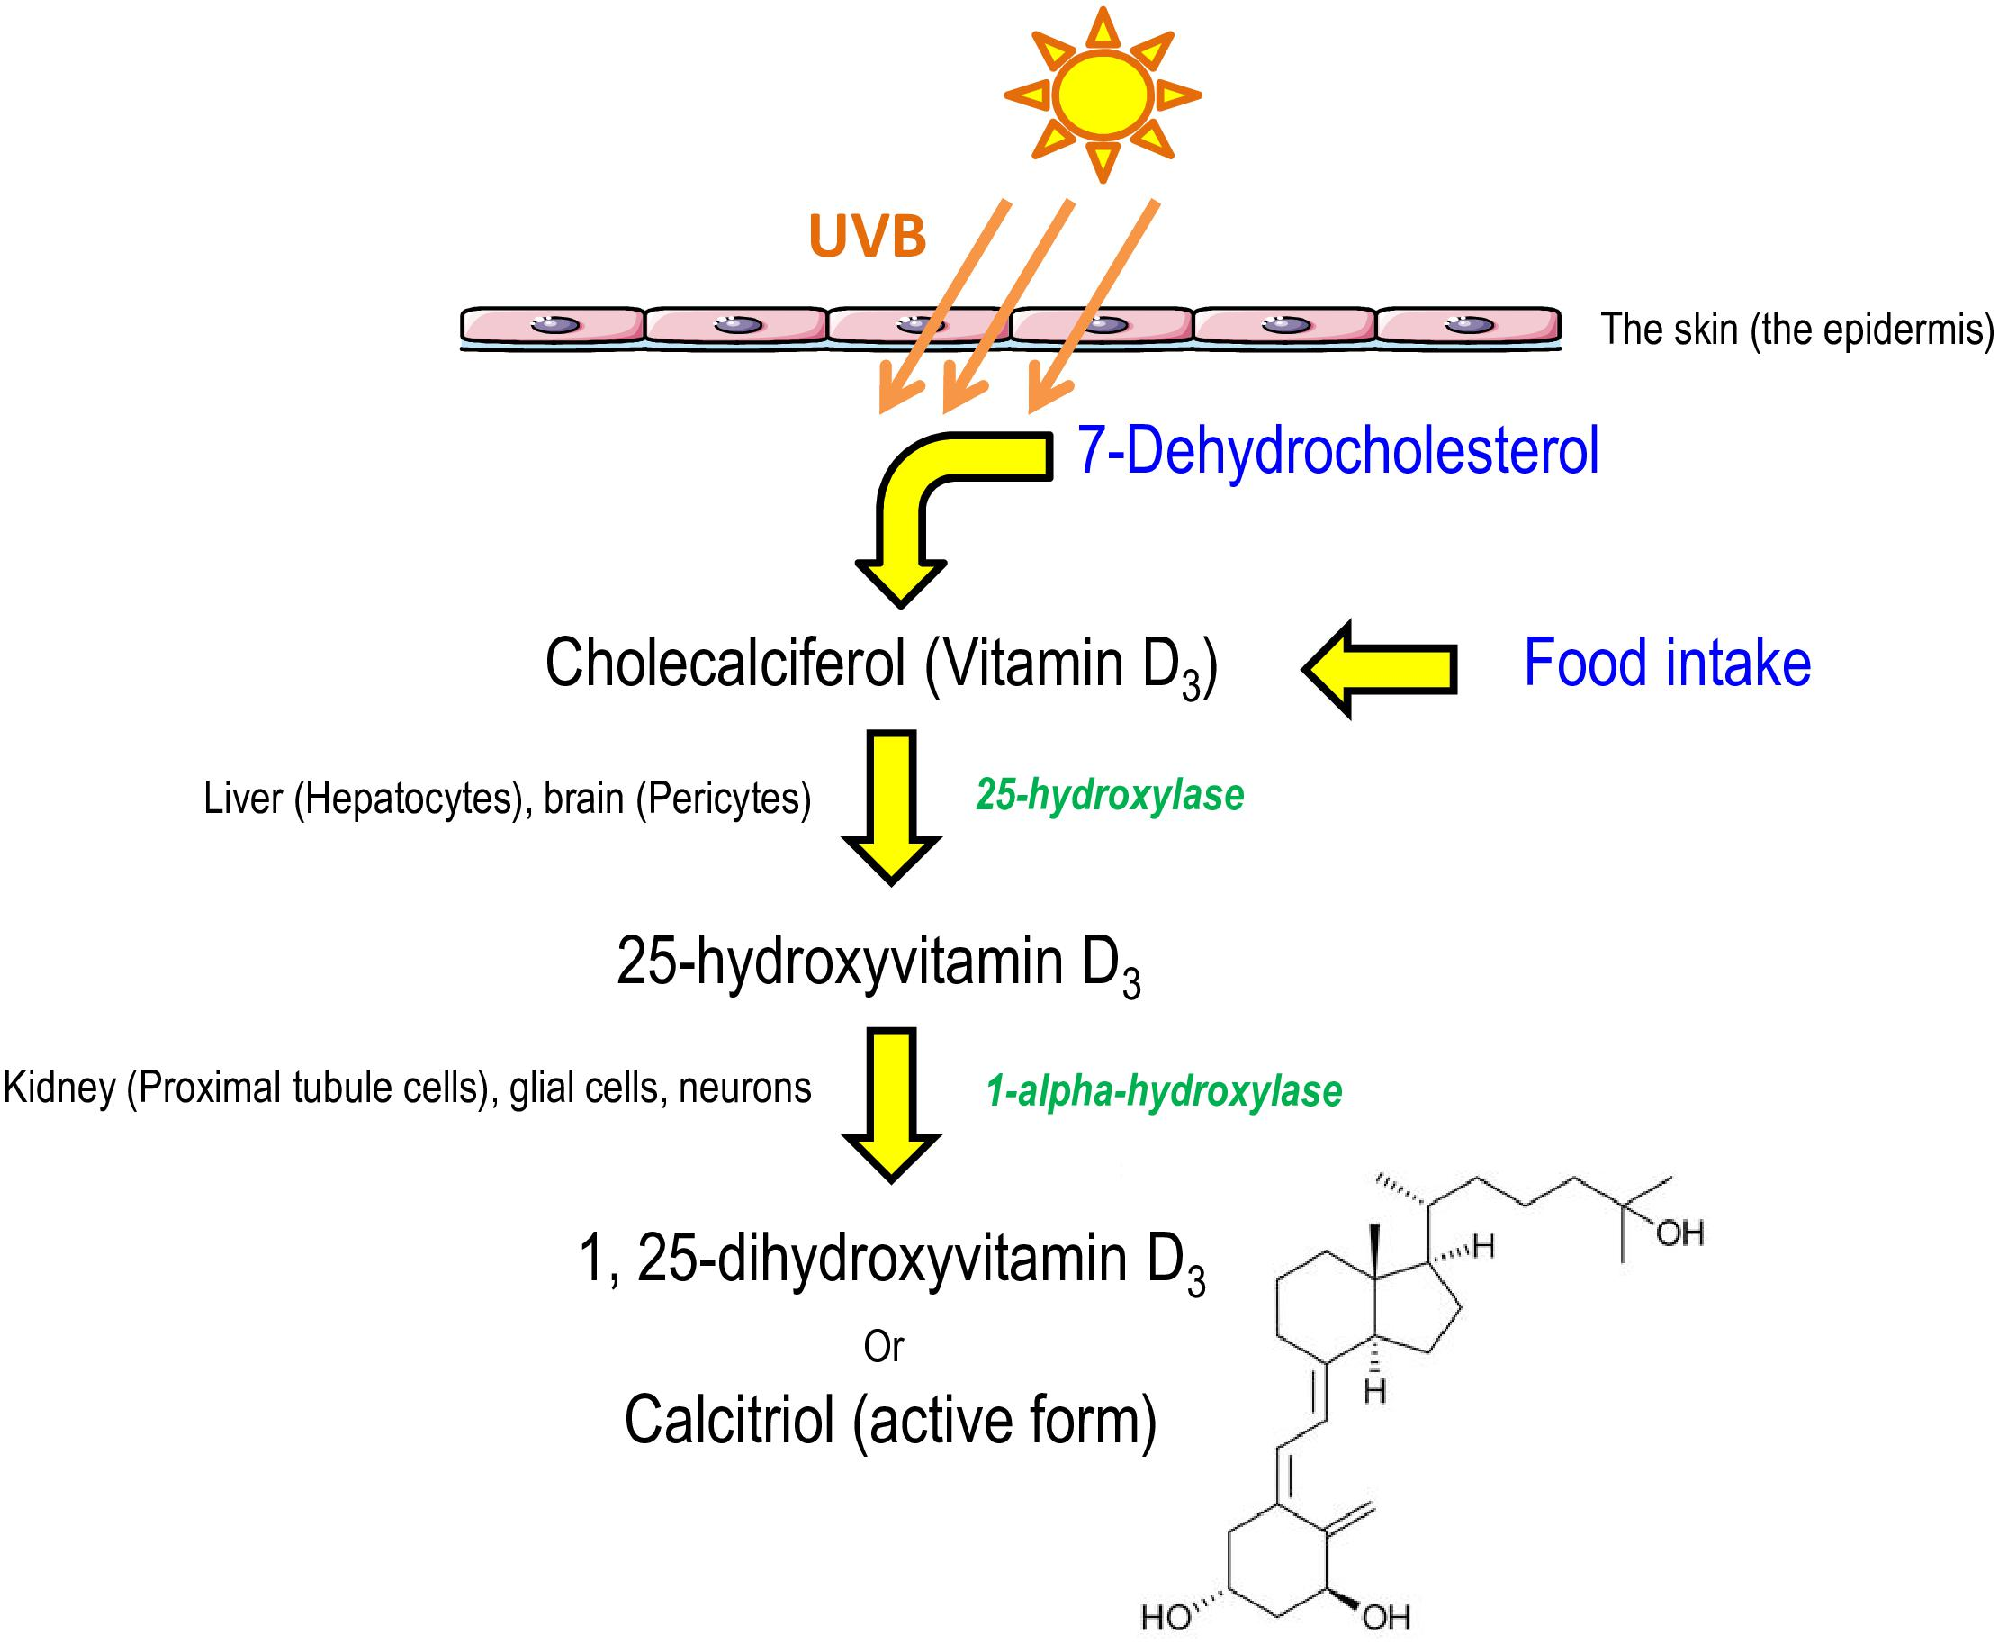
Metabolic Disorders
Fig: Biosynthesis of active form of vitamin D; calcitriol.

Slide 16
Metabolic Disorders
Rickets in children is characterized by bone deformities due to incomplete mineralization, resulting in soft and flexible bones and delay in teeth formation.
The weight bearing bones are bent to form bow-leg. In rickets, the plasma level of calcitriol is decreased and alkaline phosphatase activity is elevated.
Alkaline phosphatase is concerned with the process of bone formation. There is an overproduction of alkaline phosphatase related to more cellular activity of the bone.
In case of osteomalacia (adult rickets) demineralization of the bones occurs (bones become softer), increasing their susceptibility to fractures.

Slide 17
Metabolic Disorders
Deficiency may be due to:
dietary deficiency of vitamin D
malabsorption, e.g. coeliac disease or following gastrointestinal surgery
lack of exposure to sunlight, e.g. pigmented skin, housebound people
excessive loss of vitamin D or its precursors, e.g. in chronic renal failure, haemodialysis
drugs that result in breakdown of vitamin D, e.g. anticonvulsants, including phenytoin, diazepam,etc.

Slide 18
Metabolic Disorders
Gout

Slide 19
Metabolic Disorders
Gout:
A disturbance of uric acid metabolism (purine metabolism), characterised by painful inflammation of the joints, especially of the feet and hands and arthritic attacks resulting from elevated levels of uric acid (hyperuricemia) in the blood and deposition of urates crystals around joints. The conditions can become chronic and result in deformity.
Urate, the end product of purine base degradation, is formed from xanthine by the enzyme xanthine oxidase.
So, gout is a disorder of purine metabolism characterised by hyperuricemia, deposition of monosodium urates, monohydrates crystals in the joints and peri-articular tissues and recurrent attack of acute synovitis.
Increased excretion of uric acid may cause uric acid crystals to be deposited in the collecting tubules and lower urinary tract leading to calculi or stone formation with renal damage.

Slide 20
Metabolic Disorders
Classification of gout:
Two types:
Primary gout:
Consist of 90% of the cases
Overproduction of uric acids (purines) and increased synthesis of purine nucleotides.
Under excretion of uric acids (urates)
Often associated with a mix of dietary excess or alcohol abuse or metabolic syndrome
Many factors contribute the conversion of asymptomatic hyperuricemia into primary gout. They are:
Age of individual and duration of hyperuricemia: gout appear 20-30 yrs of hyperuricemia
Genetic predisposition: X-linked abnormalities of Hypoxanthine Guanine Phosphoribosyl Transferase (HGPRT)
Heavy alcohol consumption
Obesity
Certain drugs like thiazides diuretic
Lead toxicity

Slide 21
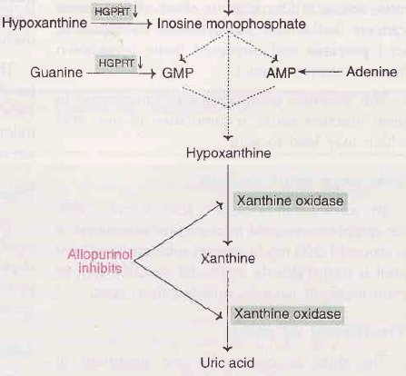
Metabolic Disorders
Fig: Hypoxanthine Guanine Phosphoribosyl Transferase (HGPRT) alteration, causing gout

Slide 22
Metabolic Disorders
Secondary gout:
It is associated with increased production or impaired excretion of urates due to some diseases like renal failure, lactic acidosis, ketoacidosis, hypertension, etc.
Increased degradation of nucleic acids (hence more uric acid formation) is observed in various cancers (leukemias, polycythemia, lymphomas, etc.), psoriasis and increased tissue breakdown (trauma, starvation, etc.).
Inborn errors of metabolism e.g., complete HGPRT deficiency.

Slide 23
Metabolic Disorders
Pathophysiology of gout:
Acute gout manifests as a sudden onset of severe inflammation in a small joints, most commonly metatarso-phalangeal joints of great toe.
Acute gout starts by the precipitation of urates crystals in the synovial space. This deposition causes in inflammatory response.
Chemotactic factors are produced; granulocytes migrate into the joints where they phagocytes urates crystals and release the glycoproteins which causes further inflammation by:
Increasing lactic acid production from inflammatory cells which causes local pH to be decreased and more urates crystals deposits in affected joints.
Releasing of lysosomal enzymes which causes joint destruction.
Repeated attack of acute gout leads to chronic gout and formation of tophi (consists of sodium urates crystals) in the affected synovial membrane.

Slide 24
Metabolic Disorders
Causes
Increase level of uric acid
Serum uric acid levels exceeds their plasma saturation point
Formation of monosodium urates crystals within a joints
Inflammatory response
Acute gout attack
Repeated gout attack
Accumulation of sod. urates crystals (tophi)
Deposited in body such as great toe, ears, renal system (urolithiasis)
Fig : Flow chart of pathogenesis of gout.

Slide 25
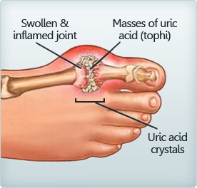
Metabolic Disorders

Slide 26
Metabolic Disorders
Normal serum uric acid value:
Male: 2-7 mg/dl, Female: 2-6 mg/dl.
Clinical features of gout:
Systemic: fever, chills, malaise
Musculoskeletal:
Red, swollen and painful joints
Monoarticular joint pain: mainly metatarsophalangeal joints of toe, others- knee, tarsal, ankles, etc.
Acute gouty arthritis: recurrent attack of severe articular and peri-articular inflammation.
Tophi: crystalline deposits in articular tissue, osseous tissues, soft tissue, cartilages.
Skin: warmth, erythema and tenderness of skin over joints.
Genitourinary: renal calculi, renal nephropathy
Anterior uveitis, scleritis and iritis.

Slide 27
Metabolic Disorders
Treatment of gout:
The drug of choice for the treatment of primary gout is allopurinol (Zyloric). This inhibits the enzyme xanthine oxidase.
This inhibition leads to the accumulation of hypoxanthine and xanthine. These two compounds are more soluble than uric acid, hence easily excreted.

Slide 28
Osteoporosis

Slide 29
Osteoporosis
Literally means ‘porous bone’.
It occurs when bone loss an excessive amount of their proteins or minerals content, particularly calcium.
Overtime, bone mass or tissue and therefore bone strength, is reduced.
As a result, bone becomes fragile and break or fracture easily and consequent pain and deformity may occur.
The condition is particularly common in elderly people and more frequent in postmenopausal women.
So, it is a metabolic bone disease resulting from low bone mass (osteopenia) due to excessive bone resorption.

Slide 30
Osteoporosis
Pathogenesis:
Osteoporosis is conventionally classified into 2 major groups: primary and secondary.
Primary osteoporosis:
Results primarily from osteopenia without an underlying disease or medication
2 types: idiopathic type found in the young and juveniles and is less frequent, and involutional type seen in postmenopausal women and aging individuals and is more common
Exact mechanism of primary osteoporosis is not known but may be due to an excessive osteoclastic resorption and slow bone formation.

Slide 31
Osteoporosis
A number of risk factors have been attributed to cause this imbalance between bone resorption and bone formation. These include the following:
Genetic factors — more marked in whites and Asians than blacks
Sex — more frequent in females than in males
Reduced physical activity — as in old age
Deficiency of sex hormones — estrogen deficiency in women as in postmenopausal osteoporosis and androgen deficiency in men.
Combined deficiency of calcitonin and estrogen
Hyperparathyroidism
Deficiency of vitamin D
Local factors—which may stimulate osteoclastic resorption or slow osteoblastic bone formation.

Slide 32
Osteoporosis
2. Secondary osteoporosis
Is attributed to a number of factors and conditions e.g.; immobilisation, chronic anaemia, acromegaly, hepatic disease, coeliac disease, hyperparathyroidism, hypogonadism, thyrotoxicosis and starvation,
Or, as an effect of medication (e.g. hypercortisonism, administration of anticonvulsant drugs and large dose of heparin).

Slide 33
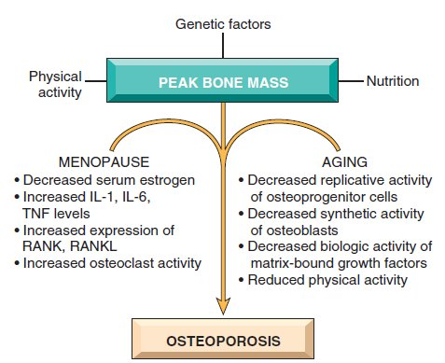
Osteoporosis
TNF: tumor necrosis factor,
RANK: (receptor activator for nuclear factor-κB) ligand
Fig: Pathophysiology of postmenopausal and senile osteoporosis
Notes:
RANK (receptor activator for nuclear factor-κB), RANK ligand (RANKL), and osteoprotegerin (OPG). RANK, a member of the tumor necrosis factor (TNF) receptor family, is expressed on the cell membranes of preosteoclasts and mature osteoclasts. Its ligand, RANKL, is expressed by osteoblasts and marrow stromal cells. RANK stimulation by RANKL leads to activation of the transcription factor NF-κB, which drives the expression of genes that stimulate osteoclast formation, fusion, differentiation, function, and survival.

Slide 34
Paget’s Disease of bone

Slide 35
Paget’s Disease of bone
Paget’s disease is defined as an idiopathic bone disorder characterised by abnormal and accelerated bone resorption and formation in one or more bones.
It involves abnormal bone destruction and re-growth, which results in deformity.
It is a chronic condition of bone characterized by disorder of normal bone remodeling process.
Normal bone has a balance of forces that act to lay down new bone and take up old bone. This relationship referred to as “bone remodeling process”, which is essential for maintaining the normal calcium levels in our body.

Slide 36
Paget’s Disease of bone
In bone affected by Paget’s disease, the bone remodeling is disturbed and not synchronized. As a result, the bone that is formed is abnormal, enlarged, not as dense, brittle, structurally weaker and prone to fracture.
It mainly affects the skull, femur, tibia, pelvis bone and vertebrate.
The newly formed bone is disordered and architecturally unsound.

Slide 37
Paget’s Disease of bone
Stages of Paget’s Disease:
The repetitive and overlapping sequence forms the bones of dividing Paget’s disease into:
Repetitive episodes of frenzied (uncontrolled), regional osteoclastic activity and bone resorption (osteolytic stage),
followed by exuberant or rapid bone formation (mixed osteoclastic-osteoblastic stage),
and finally by an apparent exhaustion of cellular activity (osteosclerotic stage).
The net effect of this process is a gain in bone mass; however, the newly formed bone is disordered and weak, so bones may become enlarged and misshapen.
Notes:
Frenzied: uncontrolled, exuberant: strong and growing quickly, exhaustion: end or collapse

Slide 38
Paget’s Disease of bone
Causes:
Idiopathic
Genetics
Family history
Viral infection in early life
A slow viral infection
Paramyxo virus
Measles virus
Respiratory syncytial virus

Slide 39
Paget’s Disease of bone
Pathogenesis:
When Sir James Paget first described this condition in 1876, he attributed the skeletal changes to an inflammatory process, hence the term osteitis deformans.
Current evidence suggests a slow virus infection by a paramyxovirus as the cause of Paget’s disease.
Viral particles resembling the nucleocapsids of paramyxovirus have been seen in the cytoplasm and nuclei of osteoclasts, and immunologic analysis have identified antigens associated with both the measles and respiratory syncytial viruses (both paramyxovirus) in osteoclasts from affected sites.

Slide 40
Paget’s Disease of bone
Pathophysiology:
Primary proliferation of osteoclasts
Bone resorption
Compensatory increases in osteoblastic activity
Replaces bone
Bone turnover continues
A classic mosaic (disorganized) pattern of bone develops

Slide 41
Paget’s Disease of bone
Clinical manifestations:
Bone pain, joint pain or stiffness and neck pain
Bowing of legs producing a waddling gait and other visible deformities
Enlarged head and skull deformities (a patient may report a hat no longer fits)
Cranium but not face is enlarged giving face a triangular appearance
Fracture
Impaired hearing from cranial nerve compression and dysfunction
Reduced height
Warm skin over the affected bone due to increased bone vascularity
Notes:
waddling : short legs and a fat body

Slide 42
Paget’s Disease of bone
Assessment and Diagnostic findings:
X-ray
Bone scan
Serum alkaline phosphatase concentration
Urinary hydroxyproline excretion (collagen i.e. aminoacid )

Slide 43
Paget’s Disease of bone
Management:
NSAIDS (Non-steroidal anti-inflammatory drugs, for relieving pain and inflammation, e.g., aspirin, paracetamol, ibuprofen)
Physical therapy, walking aids, weight control, management of fracture and hearing loss
Anti-osteoclastic therapy for moderate to severe diseases – calcitonin, biphosponates, etc.

Slide 44
Arthritis

Slide 45
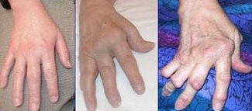
Arthritis
Definition:
It is an inflammation of joints characterised by pain, swelling and limitation of joint movement.
Arthralgia: it is a term used for pain in a joint, without any associated signs of inflammation.
Arthritis is a group of conditions involving damage to the joints of the body.
There are over 100 different forms of arthritis. The most common form, osteoarthritis (degenerative joint disease) is a result of trauma to the joint, infection of the joint, or age.
Other arthritis forms are rheumatoid arthritis, Gouty arthritis

Slide 46
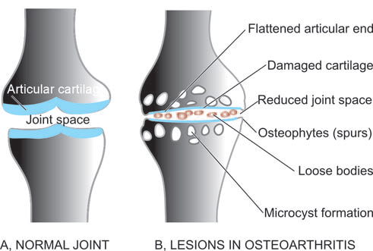
Arthritis
Fig: Fully-developed lesions in osteoarthritis (B), contrasted with appearance of a normal joint (A).

Slide 47
Arthritis
Osteoarthritis

Slide 48
Osteoarthritis
Osteoarthritis (OA, degenerative arthritis, degenerative joint disease), is a group of diseases and mechanical abnormalities involving degradation of joints, including articular cartilage and the subchondral bone next to it.
In OA, a variety of potential forces—
hereditary
developmental
metabolic
mechanical
may initiate processes leading to loss of cartilage a strong protein matrix that lubricates and cushions the joints.
Osteoarthritis (OA) rarely starts before 40, but by the age of 80 affects 80% of the population.
There are structural and functional changes in the articular cartilage, as well as changes in the collagenous matrix of tendons and ligaments.

Slide 49
Osteoarthritis
Classification:
It has been classified as:
primary (idiopathic), with no prior events or disease related to the OA. Most common in weight-bearing joints (knee and hip)
Secondary, resulting from previous joints injury or inflammatory disease; or some underlying diseases such as diabetes, ochronosis or marked obesity.
Notes:
A rare condition in which the ligaments and cartilages of the body, and sometimes the conjunctiva, become stained by dark brown or black pigment (homogentisic acid). This may occur in chronic carbolic poisoning, or in a congenital disorder of metabolism in which the individual is unable to break down completely the tyrosine of the protein molecule

Slide 50
Osteoarthritis
Pathogenesis:
The biomaterial properties of the articular cartilage and subchondral bone are normal, but excessive loading of joints causes the tissues to fail
The applied load is reasonable, but the biomaterial properties of the cartilage or bone are inferior or lesser

Slide 51
Osteoarthritis
Mechanical injury
Genetic and hormonal factors
Previous joint damage
Others
Chondrocytes Response
Release of cytokines
Stimulation, production and release of proteolytic enzymes,
metalloprotease, collagenase
Resulting damage predisposes to further damage
Fig: Pathophysiology of osteoarthritis

Slide 52
Osteoarthritis
Clinical features:
Pain
Age > 45 years (often >60)
Insidious onset over months and years
Mainly related to movements and weight-bearing, relieved by rest
Usually only one or a few joints painful (not multiple regional pain)
Restricted movements
Palpable, sometimes audible, coarse crepitus due to rough articular surfaces
Bony swelling around joint margins
Deformity
Joint-line or periarticular tenderness
Muscle weakness, wasting
No or only mild synovitis (effusion, increased warmth)

Slide 53
Rheumatoid arthritis (RA)

Slide 54
Rheumatoid arthritis (RA)
Rheumatoid arthritis (RA) is a
chronic, systemic inflammatory disorder
that may affect many tissues and organs
but principally attacks the joints producing an inflammatory synovitis
that often progresses to destruction of the articular cartilage and ankylosis of the joints.
Rheumatoid arthritis can also produce diffuse inflammation in the lungs, pericardium, pleura, and sclera, and also nodular lesions, most common in subcutaneous tissue under the skin.
Although the cause of rheumatoid arthritis is unknown, autoimmunity plays a pivotal role in its chronicity and progression.
About 1% of the world's population is afflicted by rheumatoid arthritis, women three times more often than men.
Onset is most frequent between the ages of 40 and 50, but people of any age can be affected.
Notes:
Ankylosis: The condition of a joint in which the movements are restricted by fibrous bands, or by malformation, or by actual union of the bones.

Slide 55
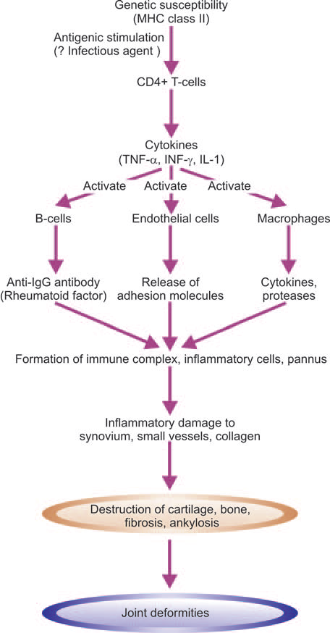
Rheumatoid arthritis (RA)
Pathogenesis:
Present concept on etiology and pathogenesis proposes that RA occurs in an immunogenetically predisposed individual to the effect of microbial agents acting as trigger antigen.
Fig: Pathogenesis of rheumatoid arthritis.

Slide 56
Rheumatoid arthritis (RA)
The proposed events in immunopathogenesis of RA are as under:
In response to antigenic exposure (e.g. infectious agent) in a genetically predisposed individual (HLA-DR), CD4+ T-cells are activated.
These cells elaborate cytokines, the important ones being tumour necrosis factor (TNF)-α, interferon (IF)-γ , interleukin (IL)-1 and IL-6.
These cytokines activate endothelial cells, B lymphocytes and macrophages.
Activation of B-cells releases IgM antibody against IgG (i.e. anti-IgG); this molecule is termed rheumatoid factor (RF).
IgG and IgM immune complexes trigger inflammatory damage to the synovium, small blood vessels and collagen.
Activated endothelial cells express adhesion molecules which stimulate collection of inflammatory cells.
Activation of macrophages releases more cytokines which cause damage to joint tissues and vascularisation of cartilage termed pannus formation.
Eventually damage and destruction of bone and cartilage are followed by fibrosis and ankylosis producing joint deformities.

Slide 57
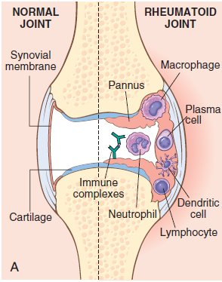
Rheumatoid arthritis (RA)

Slide 58
Rheumatoid arthritis (RA)
Signs and symptoms:
Joints become swollen, tender and warm, and stiffness limits their movement particularly early in the morning on waking or following prolonged inactivity.
Gentle movements may relieve symptoms in early stages of the disease.
RA nearly always affects multiple joints (it is a polyarthritis), most commonly small joints of the hands, feet and cervical spine, but larger joints like the shoulder and knee can also be involved.

Slide 59
Rheumatoid arthritis (RA)
Diagnosis:
It is diagnosed chiefly on symptoms and signs, but also with blood tests (especially a test called rheumatoid factor) and X-rays.
Diagnostic criteria:
Morning stiffness (≥1 hr)
Swelling of three or more joints
Swelling of hands joints (proximal interphalangeal, metacarpophalangeal, or wrist)
Symmetric joint swelling
Subcutaneous nodules
Serum rheumatoid factor
Radiographic evidence of erosion or periarticular osteopenia in hands or wrist joints
“Criteria 1 to 4 must have been continuous for 6 weeks or longer and must be observed by a physician. A diagnosis of rheumatoid arthritis requires that 4 of the 7 criteria be fulfilled”.

Slide 60
Osteomyelitis

Slide 61
Osteomyelitis
It can defined as an inflammatory pathology of bones or, it denotes inflammation of bone and marrow.
It may be a complication of any systemic infection.
All types of organisms, including viruses, parasites, fungi and bacteria, can produce osteomyelitis but organisms most frequently involved are Staphylococci, Pseudomonas and Mycobacterium tuberculosis.
Any part of bone may be involved.
Mainly two main forms of osteomyelitis (OM):
Pyogenic osteomyelitis
Tuberculosis osteomyelitis

Slide 62
Osteomyelitis
Pyogenic osteomyelitis:
Almost always caused by bacteria
Staphylococcus aureus – 80-90% of pyogenic osteomyelitis
Other includes – Streptococcus, Salmonella, Klebsiella, Pseudomonas and E. coli; last three being more frequently isolated from patients with genitourinary tract infections or who are IV drugs abusers.
Mixed bacterial infections are seen in the setting of direct spread or inoculation of organisms during surgeon or open fractures.
Organisms may reach the bone by:
Hematogenous spread
Extension from a contiguous site
Direct implantation
Most cases are hematogenous in origin and develops in the long bones or vertebral bodies.

Slide 63
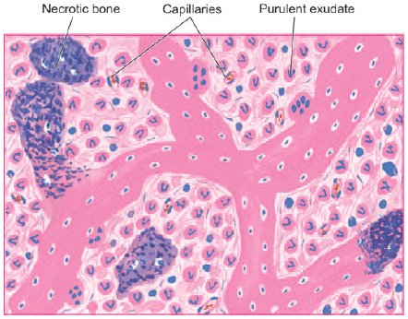
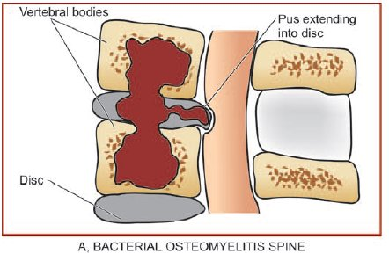
Osteomyelitis
Fig: Chronic suppurative osteomyelitis, shows necrotic bone and extensive purulent inflammatory exudate.

Slide 64
Osteomyelitis
Tuberculosis osteomyelitis:
Almost Tuberculous osteomyelitis, though rare in developed countries, continues to be a common condition in underdeveloped and developing countries of the world.
The tubercle bacilli, M. tuberculosis, reach the bone marrow and synovium most commonly by haematogenous dissemination from infection elsewhere, usually from the lungs, and infrequently by direct extension from the pulmonary or gastrointestinal tuberculosis.
Tuberculosis of spine, Pott’s disease, commences in the vertebral body and often associated with fracture and destruction of intervertebral discs.
The disease affects adolescents and young adults more often. Most frequently involved are the spine and bones of extremities.

Slide 65
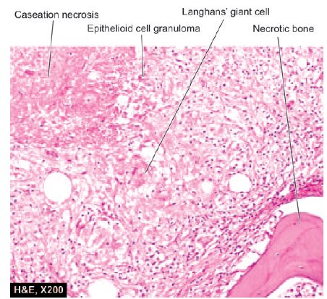
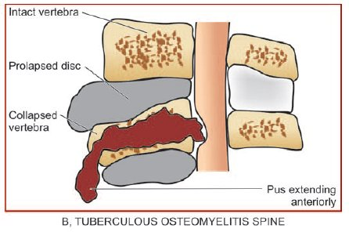
Osteomyelitis
Fig: Tuberculous osteomyelitis. There are epithelioid cell granulomas with minute areas of caseation necrosis and surrounded by Langhans’ giant cells. Pieces of necrotic bone are also seen.

Slide 66
Osteomyelitis
Risk factors:
Childhood and adolescence
Diabetes mellitus (especially involving the foot)
Immunocompromised (AIDS, Sickle cell disease)

Slide 67
Osteomyelitis
Pathophysiology:
The initial response to infection is inflammation, increased vascularity, and edema.
After 2 or 3 days, thrombosis of the local blood vessels occurs, resulting into ischemia with bone necrosis.
The infection extends into the medullary cavity and under the periosteum and may spread into adjacent soft tissues and joints.
Unless the infective process is treated properly, bone abscess forms.
The resulting abscess cavity contains dead bone tissue (the sequestrum), which does not easily liquefy and drain.
Therefore the cavity cannot collapse and heal, as it does in soft tissue abscess.

Slide 68
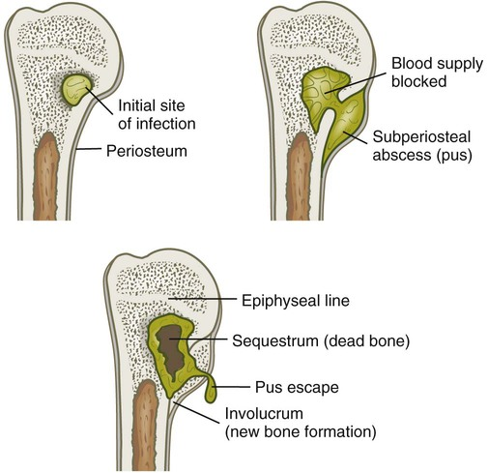
Osteomyelitis
Pathophysiology:
New bone growth (the involucrum) forms and surrounds the sequestrum.
Although healing appears to take place, a chronically infected sequestrum remains and produces recurring abscesses throughout the patient’s life.
This is referred to as
chronic osteomyelitis.
Notes:
Involucrum: The sheath of new bone which is formed round a piece of dead bone in. Sequestrum: A fragment of dead bone cast off from the living bone in the process of NECROSIS.

Slide 69
Osteomyelitis
Clinical features:
Severe pain and swelling of the affected bone associated with fever, malaise and elevated leucocytes count.
The bony lesion may form discharging sinuses which may let out necrosed bony particles.
The patient may describe a constant, pulsating pain that intensifies with movement as a result of the pressure of the collecting purulent material.
When osteomyelitis occurs from spread of adjacent infection or from direct contamination, there are no symptoms of sepsis. The area is swollen, warm, painful and tender to touch.

Slide 70
Osteomyelitis
Management:
Parenteral antibiotics for at least 2 weeks, followed by oral antibiotics or at least 4 weeks.
Complications:
Septicemia
Extension of infection into the joint spaces – infective arthritis, pathological fracture and secondary amyloidosis.

Slide 71
Definition of:
Osteogenesis imperfect: (disorder of osteoblasts)
A hereditary disease caused by a collagen abnormality, causing fragility of the skeleton which results in fractures and deformities. Also called brittle bone syndrome or Lobstein syndrome.
Achondroplasia: (disorder of chondroblasts)
A genetic disorder disturbing normal growth of cartilage into bone resulting in a form of dwarfism characterised by a usually normal torso and shortened limbs, and usually inherited as an autosomal dominant trait.
Osteopetrosis: (disorder of osteoclasts)
Also called marble bone disease, is an autosomal dominant or recessive disorder of increased skeletal mass or osteosclerosis caused by a hereditary defect in osteoclast function. Failure of normal osteoclast function of bone resorption coupled with continued bone formation and endochondral ossification results in net overgrowth of calcified dense and hard bone (too much bone) which occupies most of the available marrow space.

Slide 72
Bone tumors

Slide 73
Bone tumors
Bone tumors are diverse in their gross and morphologic features and range in their biologic potential from their innocuous to the rapidly fatal.
Most bone tumor classify accordingly to the normal cell or tissue of origin.
Overall, matrix-producing and fibrous tumors are the most common, and among the benign tumors, osteochondroma and fibrous cortical defect occur most frequently.
Osteosarcoma is the most common primary bone cancer, followed by chondrosarcoma and Ewing sarcoma.
Benign tumors greatly outnumber their malignant counterparts, particularly before the age of 40 years; bone tumors in elderly persons are much more likely to be malignant.

Slide 74
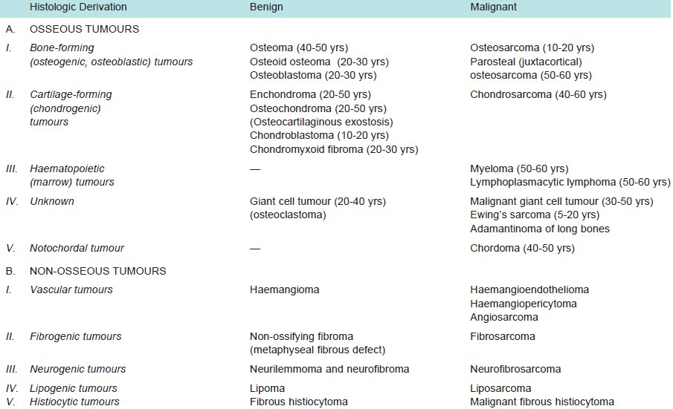
Bone tumors
TABLE: Classification of Primary Bone Tumours.

Slide 75
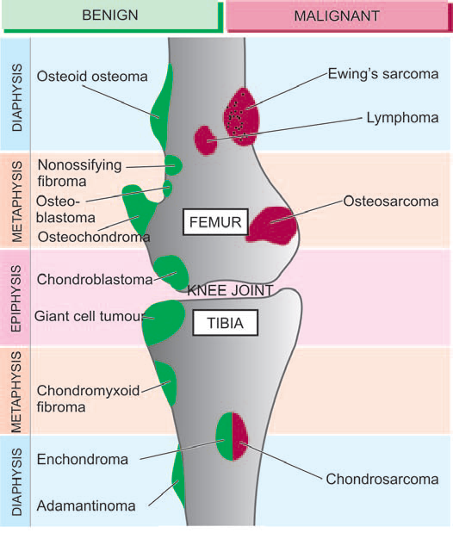
Bone tumors
Fig: Anatomic locations of common primary bone tumours.

Slide 76
Bone tumors
Osteoma:
An osteoma is a rare benign, slow-growing lesion. Similar lesions may occur following trauma, subperiosteal haematoma or local inflammation.
Osteoid osteoma :
It is small (usually less than 1 cm) and painful tumour, located in the cortex of a long bone. The tumour is clearly differentiate having surrounding zone of reactive bone formation which radiographically appears as a small central focus or nidus surrounded by dense sclerotic bone.
Osteoblastoma:
It is larger in size (usually more than 1 cm), painless, located in the medulla, commonly in the vertebrae, ribs, ilium and long bones, and there is absence of reactive bone formation.

Slide 77
Bone tumors
Osteosarcoma

Slide 78
Bone tumors
Osteosarcoma:
Osteosarcoma or osteogenic sarcoma is the most common primary malignant tumour of the bone.
The tumour is characterised by formation of osteoid or bone, directly by sarcoma cells. The tumour is thought to arise from primitive osteoblast-forming mesenchyme.
Osteosarcomas occur in all age groups, usually in association with other conditions, including Paget disease, bone infarcts, and previous irradiation.
Men are more commonly affected than women.
Although any bone can be involved, most tumors arise in the metaphyseal region of the long bones of the extremities, with almost 60% occurring about the knee, 15% around the hip, 10% at the shoulder, and 8% in the jaw.

Slide 79
Bone tumors
Osteosarcoma:
MORPHOLOGY
On gross evaluation, osteosarcomas are gritty-appearing, gray-white tumors, often exhibiting hemorrhage and cystic degeneration.
Tumors frequently destroy the surrounding cortices, producing soft tissue masses.
They spread extensively in the medullary canal, infiltrating and replacing the marrow but only infrequently penetrating the epiphyseal plate or entering the joint space.
Tumor cells vary in size and shape and frequently have large hyperchromatic nuclei; bizarre tumor giant cells are common, as are mitotic figures.
The production of mineralized or unmineralized bone (osteoid) by malignant cells is essential for diagnosis of osteosarcoma.

Slide 80
Bone tumors
Osteosarcoma:
MORPHOLOGY
Cartilage and fibroblastic differentiation can also be present in varying amounts.
When malignant cartilage is abundant, the tumor is called a chondroblastic osteosarcoma.
Vascular invasion is common, as is spontaneous tumor necrosis.

Slide 81
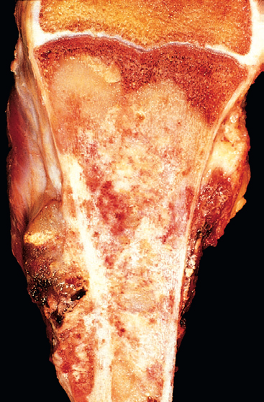
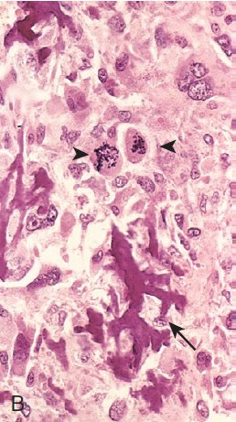
Bone tumors
Osteosarcoma:
A
A
Fig: Osteosarcoma. A, Mass involving the upper end of the tibia. The tan-white tumor fills most of the medullary cavity of the metaphysis and proximal diaphysis. It has infiltrated through the cortex, lifted the periosteum, and formed soft tissue masses on both sides of the bone. B, Histologic appearance, with coarse, lacelike pattern of neoplastic bone (arrow) produced by anaplastic tumor cells. Note the wildly aberrant mitotic figures (arrowheads).

Slide 82
Bone tumors
Osteosarcoma:
PATHOGENESIS
Several mutations are closely associated with the development of osteosarcoma.
In particular, RB gene mutations occur in 60% to 70% of sporadic tumors, and persons with hereditary retinoblastomas (due to germline mutations in the RB gene) have a thousand-fold greater risk for development of osteosarcoma.

Slide 83
Bone tumors
Osteosarcoma:
CLINICAL FEATURES
Osteosarcomas typically manifest as painful enlarging masses, although a pathologic fracture can be the first sign.
Radiographic imaging usually shows a large, destructive, mixed lytic and blastic mass with indistinct infiltrating margins.
The tumor frequently breaks through the cortex and lifts the periosteum, resulting in reactive periosteal bone formation.
A triangular shadow on the x-ray film between the cortex and raised periosteum (Codman’s triangle) is characteristic of osteosarcomas.
Osteosarcomas typically spread hematogenously.

Slide 84
Bone tumors
Parosteal or juxtacortical osteosarcoma:
Uncommon form of osteosarcoma having its origin from the metaphysis on the external surface of the bone (parosteal or juxtacortical means outer to cortex).
The tumour occurs in older age group, has no sex predilection and is slow growing.
Its common locations are metaphysis of long bones, most frequently lower end of the femur and upper end of the humerus.
X-ray examination usually reveals a dense bony mass attached to the outer cortex of the affected long bone.
Periosteal osteosarcoma:
Rare form of osteosarcoma that arises between the cortex and the overlying periosteum.
Its common location is the diaphysis of the tibia or the femur.

Slide 85
Bone tumors
Cartilage-Forming Tumors:
Cartilage-forming tumors produce hyaline cartilage; fibrocartilage and elastic cartilage are rare components.
Like the bone-forming tumors, cartilaginous tumors constitute a spectrum from benign, self-limited growths to highly aggressive malignancies; again, benign cartilage tumors are much more common than malignant ones.

Slide 86
Bone tumors
Osteochondromas (Osteocartilaginous Exostoses )
Commonest of benign cartilage-forming lesions.
Not a true tumour but is regarded as a disorder of growth and development.
Exostoses arise from metaphyses of long bones as exophytic lesions, most commonly lower femur and upper tibia (i.e. around knee) and upper humerus but may also be found in other bones such as the scapula or ilium.
Commonly in late childhood or adolescence and are more frequent in males.
They may remain asymptomatic and discovered as an incidental radiographic finding or may produce obvious deformity.

Slide 87
Bone tumors
Osteochondromas (Osteocartilaginous Exostoses )
MORPHOLOGY
Osteochondromas range from 1 to 20 cm in size and have a cartilaginous cap that is usually less than 2 cm in thickness.
Newly formed bone forms the inner portion of the head and stalk, with the stalk cortex and central region merging with the cortex and medullary cavity, respectively, of the host bone.
CLINICAL FEATURES
Slow-growing masses, painful if they impinge on a nerve or if the stalk is fractured. In many cases, they are incidental findings.
In multiple hereditary osteochondromas, deformity of the primary bone suggests an associated disturbance in epiphyseal growth.

Slide 88
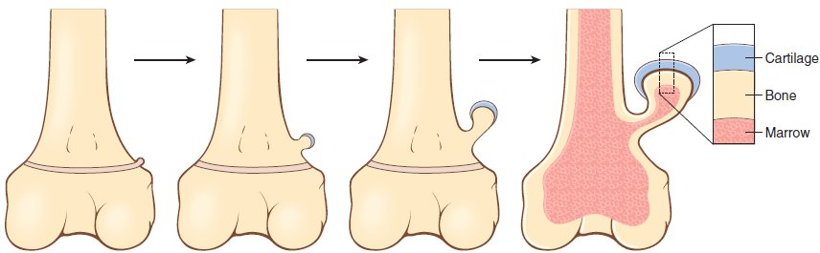
Bone tumors
Fig: The development of an osteochondroma, beginning with an outgrowth from the epiphyseal cartilage.

Slide 89
Bone tumors
Enchondroma
Benign cartilage-forming tumour that develops centrally within the interior of the affected bone, while chondroma refers to the peripheral development of lesion similar to osteochondromas.
Enchondromas may occur singly or they may be multiple
Chondroblastoma
Chondroblastoma is a relatively rare benign tumour arising from the epiphysis of long bones adjacent to the epiphyseal cartilage plate.
Most commonly affected bones are upper tibia and lower femur (i.e. about knee) and upper humerus.
Histologically, the tumour is highly cellular and is composed of small, round to polygonal mononuclear cells resembling chondroblasts and has multinucleate osteoclast-like giant cells. There are small areas of cartilaginous intercellular matrix and focal calcification.

Slide 90
Bone tumors
Chondrosarcoma
Malignant tumour of chondroblasts
Relatively slow-growing and thus has a much better prognosis than that of osteosarcoma
Two types of chondrosarcoma are distinguished: central and peripheral.
Central chondrosarcoma is more common and arises within the medullary cavity of diaphysis or metaphysis. This type of chondrosarcoma is generally primary i.e. occurs de novo.
Peripheral chondrosarcoma arises in the cortex or periosteum of metaphysis. It may be primary or secondary occurring on a pre-existing benign cartilaginous tumour

Slide 91
Bone tumors
Chondrosarcoma
MORPHOLOGIC FEATURES
Grossly, chondrosarcoma may vary in size from a few centimeters to extremely large and lobulated masses of firm consistency. Cut section of the tumour shows translucent, bluish-white, gelatinous or myxoid appearance with foci of ossification.
Histologically, the two hallmarks of chondrosarcoma are: invasive character and formation of lobules of anaplastic cartilage cells. These tumour cells show cytologic features of malignancy such as hyperchromatism, pleomorphism, two or more cells in the lacunae and tumour giant cells.

Slide 92
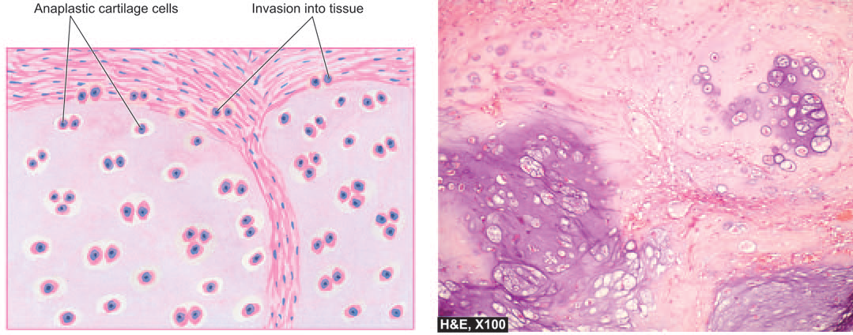
Bone tumors
Chondrosarcoma
Fig: Chondrosarcoma. Histologic features include invasion of the tumour into adjacent soft tissues and cytologic characteristics of malignancy in the tumour cells.

Slide 93
Bone tumors
Giant cell tumour (osteoclastoma)
Giant cell tumour or osteoclastoma is a distinctive neoplasm with uncertain histogenesis and hence classified separately.
The tumour arises in the epiphysis of long bones close to the articular cartilage. Most common sites of involvement are lower end of femur and upper end of tibia (i.e. about the knee), lower end of radius and upper end of fibula.
MORPHOLOGIC FEATURES
The tumour is well-circumscribed, dark-tan and covered by a thin shell of subperiosteal bone. Cut surface of the tumour is characteristically haemorrhagic, necrotic, and honey-combed due to focal areas of cystic degeneration.
Histologically, the hallmark features of giant cell tumour are the presence of large number of multinucleate osteoclast-like giant cells regularly scattered throughout the stromal mononuclear cells
Giant cells often contain as many as 100 benign nuclei and have many similarities to normal osteoclasts. These cells have very high acid phosphatase activity.

Slide 94
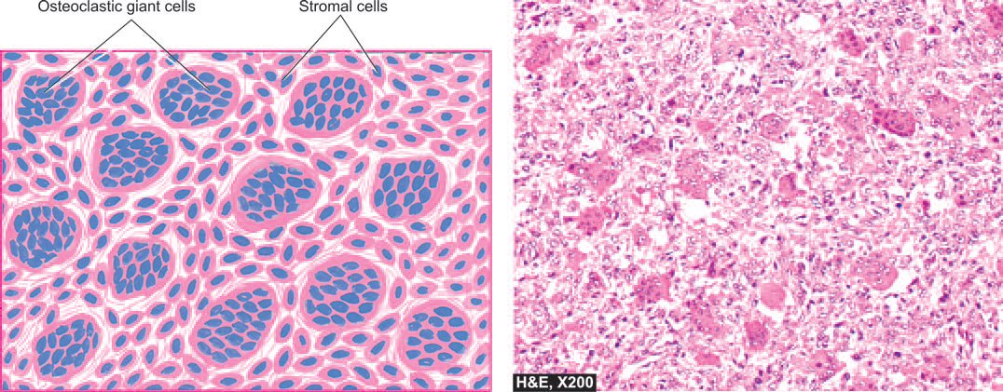
Bone tumors
Giant cell tumour (osteoclastoma)
Fig: Osteoclastoma. Microscopy reveals osteoclast-like multinucleate giant cells which are regularly distributed among the mononuclear stromal cells.

Slide 95
Soft tissue tumors

Slide 96
Soft tissue tumors
By convention, the term soft tissue describes any non-epithelial tissue other than bone, cartilage, central nervous system, hematopoietic, and lymphoid tissues.
Soft tissue tumors, which are classified according to the tissue, including fat, fibrous tissue, and neurovascular tissue.
The lesions of these tissues are embryologically derived from mesoderm, except those of peripheral nerve which are derived from ectoderm.

Slide 97
Soft tissue tumors
Important general features of soft tissue tumours:
Superficially-located tumours tend to be benign while deep-seated lesions are more likely to be malignant.
Large-sized tumours are generally more malignant than small ones.
Rapidly-growing tumours often behave as malignant tumours than those that develop slowly.
Malignant tumours have frequently increased vascularity while benign tumours are selectively avascular.
Although soft tissue tumours may arise anywhere in the body but in general more common locations are: lower extremity (40%), upper extremity (20%), trunk and retroperitoneum (30%) and head and neck (10%).
Generally, males are affected more commonly than females.
Approximately 15% of soft tissue tumours occur in children and include some specific examples of soft tissue sarcomas e.g. rhabdomyosarcoma, synovial sarcoma.

Slide 98
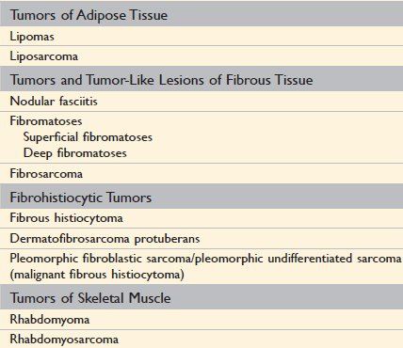
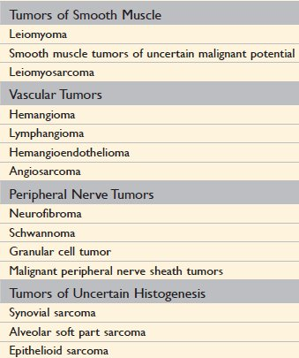
Soft tissue tumors
Table: soft tissue tumors

Slide 99
Soft tissue tumors
LIPOMA
Lipomas is the benign, commonest soft tissue tumour of fat.
It appears as a solitary, soft, movable and painless mass which may remain stationary or grow slowly.
Lipomas occur most often in 4th to 5th decades of life and are frequent in females.
They may be found at different locations in the body but most common sites are the subcutaneous tissues in the neck, back and shoulder.
A lipoma rarely ever transforms into liposarcoma.

Slide 100
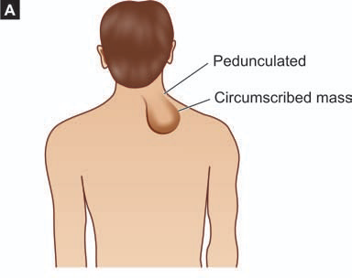
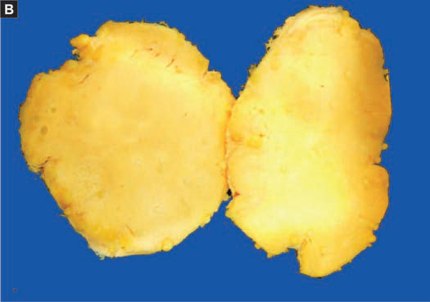
Soft tissue tumors
LIPOMA
Fig: Lipoma. A, Common clinical location. B, The cut surface of the tumour is soft, lobulated, yellowish and greasy.

Slide 101
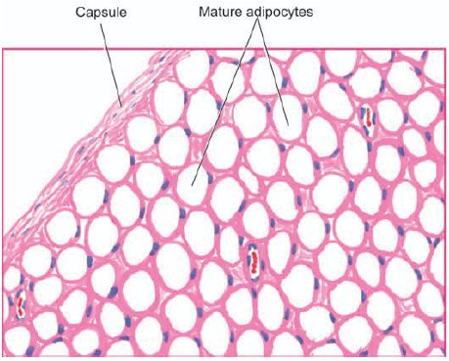
Soft tissue tumors
LIPOMA
Grossly, a subcutaneous lipoma is usually small, round to oval and encapsulated mass. The cut surface is soft, lobulated, yellowish-orange and greasy.
Histologically, the tumour is composed of lobules of mature adipose cells separated by delicate fibrous septa. A thin fibrous capsule surrounds the tumour.
Fig: Lipoma. The tumour shows a thin capsule and underlying lobules of mature adipose cells separated by delicate fibrous septa.

Slide 102
Soft tissue tumors
LIPOSARCOMA
Liposarcomas are malignant neoplasms with adipocyte differentiation.
They occur most commonly in the fifth to seventh decades of life.
Most liposarcomas arise in the deep soft tissues as in intermuscular regions in the thigh, buttocks and retroperitoneum.
Unlike lipoma which originates from mature adipose cells, liposarcoma arises from primitive mesenchymal cells, the lipoblasts.

Slide 103
Soft tissue tumors
LIPOSARCOMA
Grossly,
Liposarcoma appears as a nodular mass, 5 cm or more in diameter.
The tumour is generally circumscribed but infiltrative.
Cut surface is grey-white to yellow, myxoid or gelatinous.
Retroperitoneal masses are generally much larger.
Histologically,
The hallmark of diagnosis of liposarcoma is the identification of variable number of lipoblasts which may be univacuolated or multivacuolated.
The vacuoles represent fat in the cytoplasm.
Major histologic varieties of liposarcomas are distinguished: well-differentiated, myxoid, round cell, and pleomorphic.

Slide 104
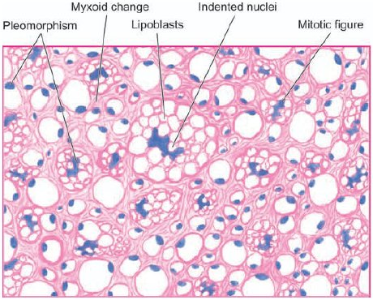
Soft tissue tumors
LIPOSARCOMA
Fig: Liposarcoma. The tumour shows characteristic, univacuolated and multivacuolated lipoblasts with bizarre nuclei.

Slide 105
Soft tissue tumors
SKELETAL MUSCLE TUMOURS
Rhabdomyoma and rhabdomyosarcoma are the rare benign and malignant tumours respectively of striated muscle.

Slide 106
Soft tissue tumors
Leiomyoma

Slide 107
Soft tissue tumors
SMOOTH MUSCLE TUMORS
Leiomyoma:
Benign smooth muscle tumors, or leiomyomas, are common, well-circumscribed neoplasms that can arise from smooth muscle cells anywhere in the body but are encountered most commonly in the uterus and the skin.
Leiomyomas or fibromyomas, commonly called fibroids by the gynaecologists, are the most common uterine tumours of smooth muscle origin, often admixed with variable amount of fibrous tissue component.
About 20% of women above the age of 30 years harbour uterine myomas of varying size.
Vast majority of them are benign and cause no symptoms.
Malignant transformation occurs in less than 0.5% of leiomyomas.
Symptomatic cases may produce abnormal uterine bleeding, pain, symptoms due to compression of surrounding structures and infertility.

Slide 108
Soft tissue tumors
SMOOTH MUSCLE TUMORS
Leiomyoma:
The cause of leiomyomas is unknown but the possible stimulus to their proliferation is estrogen.
This is evidenced by increase in their size in pregnancy and high dose estrogen-therapy and their regression following menopause and castration.
Other possible factors implicated in its etiology are human growth hormone and sterility.

Slide 109
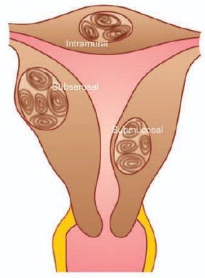
Soft tissue tumors
SMOOTH MUSCLE TUMORS
Leiomyoma:
MORPHOLOGIC FEATURES
Leiomyomas are most frequently located in the uterus where they may occur within the myometrium (intramural or interstitial), the serosa (subserosal), or just underneath the endometrium (submucosal).
Subserosal and submucosal leiomyomas may develop pedicles and protrude or stick out as pedunculated myomas. Leiomyomas may involve the cervix or broad ligament.
Fig 1 : Leiomyomas, Diagrammatic appearance of common locations and characteristic whorled appearance on cut section.

Slide 110
Soft tissue tumors
SMOOTH MUSCLE TUMORS
Leiomyoma:
Grossly,
Irrespective of their location, leiomyomas are often multiple, circumscribed, firm, nodular, grey-white masses of variable size.
On cut section, they exhibit characteristic whorled pattern (Fig 1).
Fig 1 : Leiomyomas, Diagrammatic appearance of common locations and characteristic whorled appearance on cut section.

Slide 111
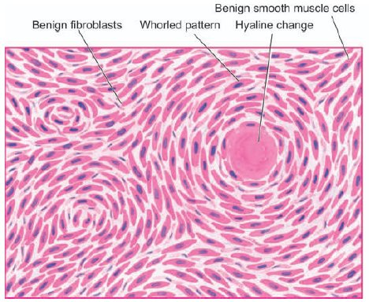
Soft tissue tumors
SMOOTH MUSCLE TUMORS
Leiomyoma:
Histologically,
They are essentially composed of 2 tissue elements—whorled bundles of smooth muscle cells admixed with variable amount of connective tissue.
The smooth muscle cells are uniform in size and shape with abundant cytoplasm and central oval nuclei (Fig 2).
Fig 2 : Leiomyoma uterus. Microscopy shows whorls of smooth muscle cells which are spindle-shaped, having abundant cytoplasm and oval nuclei.

Slide 112
MUSCULAR DYSTROPHY

Slide 113
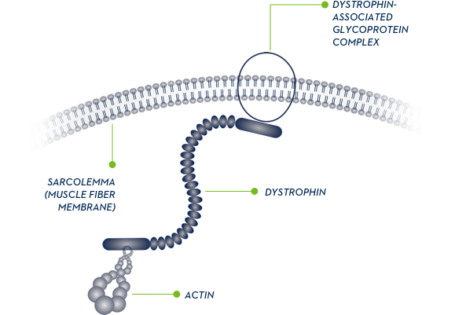
MUSCULAR DYSTROPHY
Muscular dystrophies are inherited diseases that result in progressive muscle injury (weakening and wasting) in patients who usually appear normal at birth.
Genetics
X-linked inheritance
Dystrophin gene is on the X chromosome (Xp21)
Dystrophin protein is an important muscle structural protein
Mutation results in a virtual absence of dystrophin protein
Clinical presentation
Normal at birth with onset of symptoms by age 5
Progressive muscular weakness
Proximal weakness of shoulder and pelvic girdles
Pseudohypertrophy of calf
Heart failure and arrhythmias may occur
Respiratory insufficiency and pulmonary infections

Slide 114
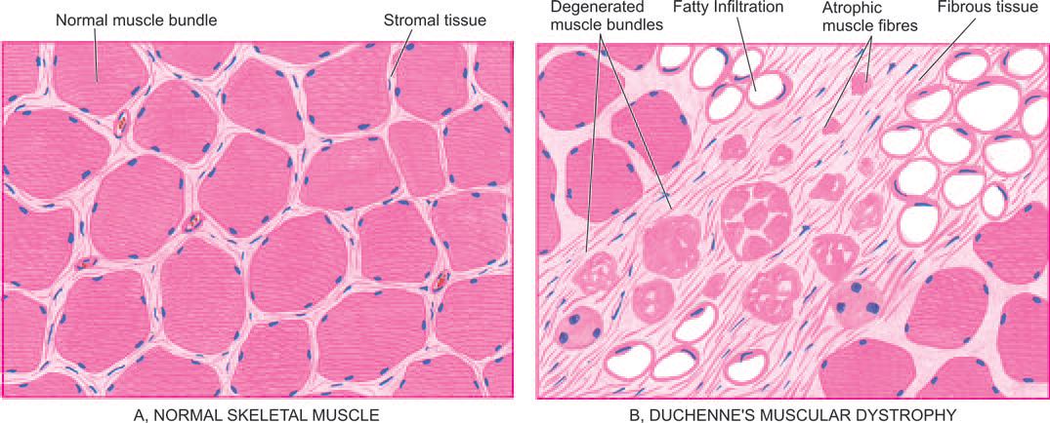
MUSCULAR DYSTROPHY
Microscopic features:
Muscle fibers of various sizes
Necrosis, degeneration, and regeneration of fibers
Fibrosis
Fatty infiltration

Slide 115
MUSCULAR DYSTROPHY
Types:
Six major forms of muscular dystrophy:
Duchenne’s
Becker’s
Myotonic
Facio-scapulohumeral
Limb-girdle
Oculopharyngeal type.
Diagnosis
Muscle biopsy: immunostains show decreased dystrophin protein
DNA analysis by PCR
Treatment:
Although disease cannot be cure, physiotherapy and orthopaedic measures can relieve the disability. The identification of the gene abnormality raises the possibility of gene therapy in the future.

Slide 116
The end…!!!

